Slide 1
Introduction to Transaction Processing
Session 37
© 2016 KL University – The contents of this presentation are an intellectual and copyrighted property of KL University. ALL RIGHTS RESERVED

Slide 2
Transaction - Definition
A transaction is defined as group of tasks [1].
Single task – It is the minimum processing unit which you can’t be divided further more [1]. At most one user can use the system.
A transaction is a logical unit of database.
Concurrency
Interleaved processing:
Concurrent execution of processes is interleaved in a single CPU
Parallel processing:
Processes are concurrently executed in multiple CPUs [text book ppt]
https://www.cs.purdue.edu/homes/ake/cs348/Chapter17.ppt
© 2016 KL University – The contents of this presentation are an intellectual and copyrighted property of KL University. ALL RIGHTS RESERVED

Slide 3
A transaction includes one or more access operations like
read – retrieval
write - insert or update, delete
An application program contain quite a few transactions separated by the Begin and End transaction boundaries.
A database is a collection of related data items.
Granularity of data - a field, a record , or a whole disk block (Concepts are independent of granularity)
The basic operations are read and write
  read_item(X): Reads a database item named X into a program variable.
  write_item(X): Writes the value of program variable X into the database item named X.
© 2016 KL University – The contents of this presentation are an intellectual and copyrighted property of KL University. ALL RIGHTS RESERVED

Slide 4

Let us take two sample transactions a – transaction T1 b – transaction T2
© 2016 KL University – The contents of this presentation are an intellectual and copyrighted property of KL University. ALL RIGHTS RESERVED

Slide 5
A transaction is understood as an execution of a user program[2].
We can have an access to database by using two operations:
a) read(x): Performs the reading operation of data item x from the database.
b) write(x): Performs the writing operation of data item x to the database.
For example, Let T1 be a transaction that transfers Rs 50 from account X to account Y. This can be explained as:
T1: read(X); Y:=Y+50;
X:= X-50; write(Y);
write(X);
read(Y);
© 2016 KL University – The contents of this presentation are an intellectual and copyrighted property of KL University. ALL RIGHTS RESERVED

Slide 6
Slides 6-9 are from Elmasri & Navathe
Why Concurrency Control is needed:
The Lost Update Problem
  This problem occurs when two transactions that access the same database items have their operations interleaved in a way that makes the value of some database item incorrect.
The Temporary Update (or Dirty Read) Problem
  This problem occurs when one transaction updates a database item and then the transaction fails due to some reason.
  The updated item is accessed by another transaction before it is changed back to its original value.
The Incorrect Summary Problem
  If one transaction is calculating an aggregate summary function on a number of records while the other transactions are updating some of these records, the aggregate function may calculate some values before they are updated and others after they are updated.
© 2016 KL University – The contents of this presentation are an intellectual and copyrighted property of KL University. ALL RIGHTS RESERVED

Slide 7
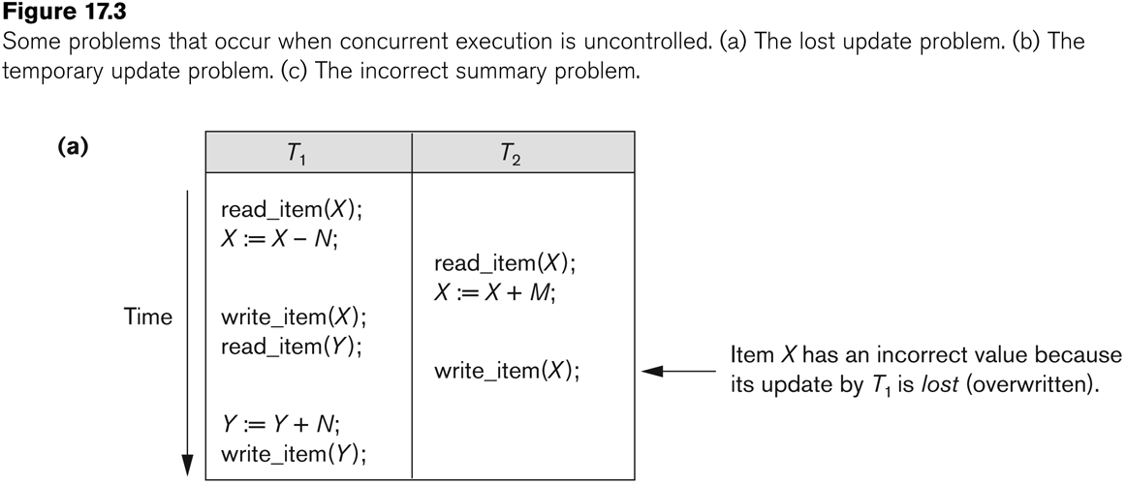
Concurrent execution is uncontrolled: (a) The lost update problem.
© 2016 KL University – The contents of this presentation are an intellectual and copyrighted property of KL University. ALL RIGHTS RESERVED

Slide 8
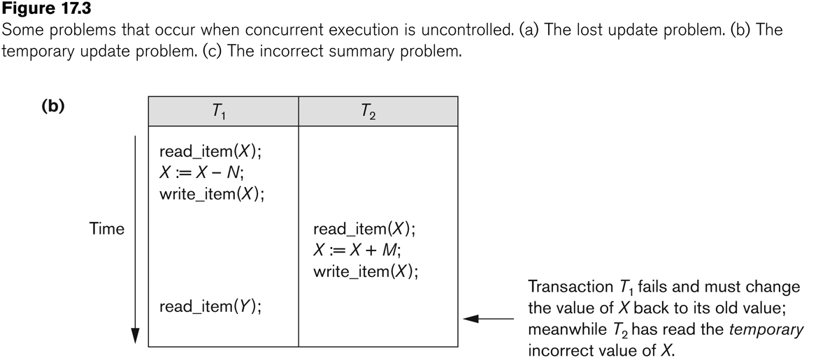
Concurrent execution is uncontrolled: (b) The temporary update problem.
© 2016 KL University – The contents of this presentation are an intellectual and copyrighted property of KL University. ALL RIGHTS RESERVED

Slide 9
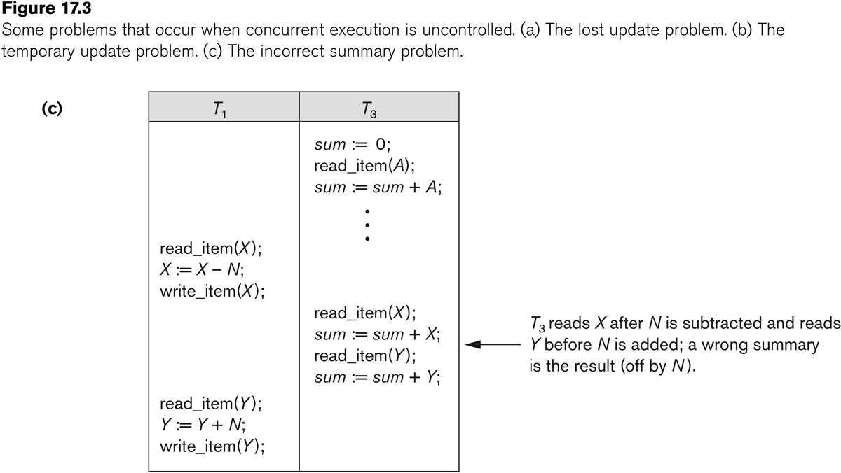
Concurrent execution is uncontrolled: (c) The incorrect summary problem.
© 2016 KL University – The contents of this presentation are an intellectual and copyrighted property of KL University. ALL RIGHTS RESERVED

Slide 10
What is the need for recovery?
What are the reasons for a transaction to fail?
A computer failure
A transaction or system error:
Local errors or exception conditions detected by the transaction:
Concurrency control enforcement
Disk failure
Physical problems and catastrophes (diaster)
© 2016 KL University – The contents of this presentation are an intellectual and copyrighted property of KL University. ALL RIGHTS RESERVED

